Slide 1
ASP_PROJECT_2021 “Take-away”
S/A
By Di Falco Simon & Huygebaert Amandine

Slide 2
Statement
A
Create a web platform to enable a take-away system
Concerns several restaurants;
A restaurant owner lists his restaurant menus and dishes;
Home delivery possible;
The customer can create an account
The connected customer can order
A visitor can consult the menus without authenticating himself

Slide 3
Analysis
A
Thinking before you program
object-oriented language is complex
Define the scope of work with the client
COMMUNICATION !
Whit what?
UML language
Standard modeling language
Diagram
It exists thirteen diagram.
Three of them
Use case diagram, class diagram and sequence diagram.

Slide 4
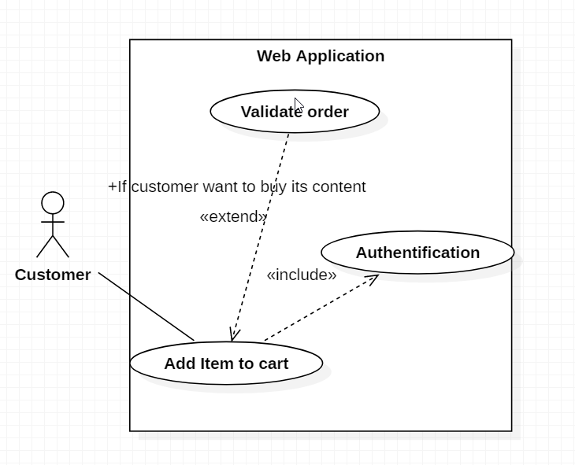
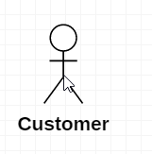
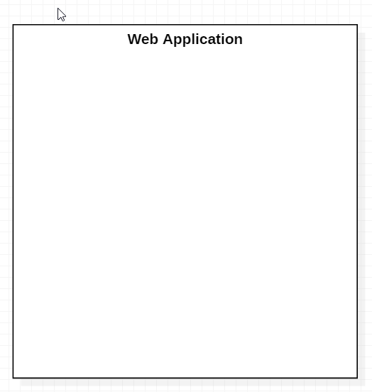

Use case diagram : theory
S
For what purpose?
Starting point
Presents clearly the features to the customer
How does it work ?
Include & extend case
Actor
System
Use case
« what can the actor do in the system? »
« Who use the system ? »
Not always humain !
« What is the project? »

Slide 5
Use case diagram :
S
Visitor
Customer
Restorer
Generalization
The customer and restorer can do everything that a visitor can do
The visitor can’t do what customer an a restorer can do
Inheritance : from visitor to customer

Slide 6
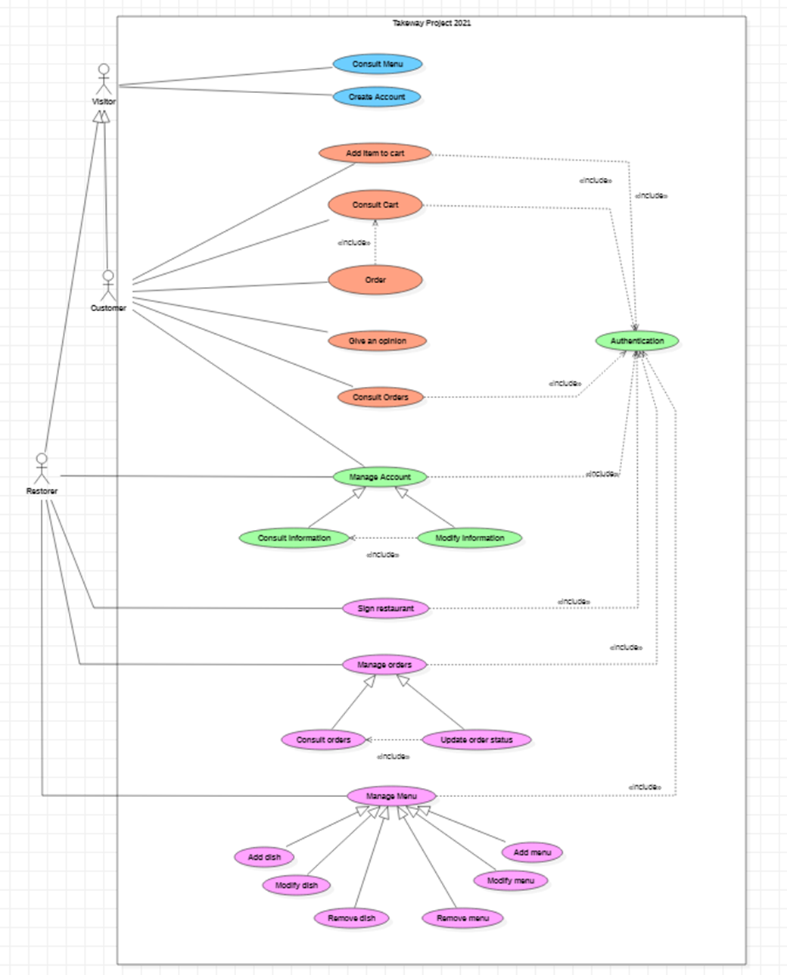

Slide 8


Slide 9
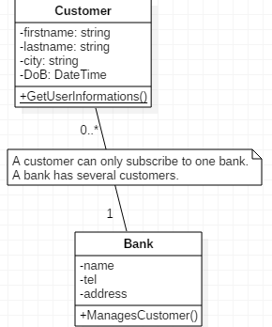
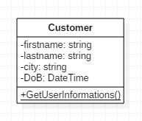
Class diagram : theory
A
For what purpose?
Models static classes and interfaces and the relationships between them.
How does it work ?
Class
Privates attributes
Static operation
Association

Slide 10
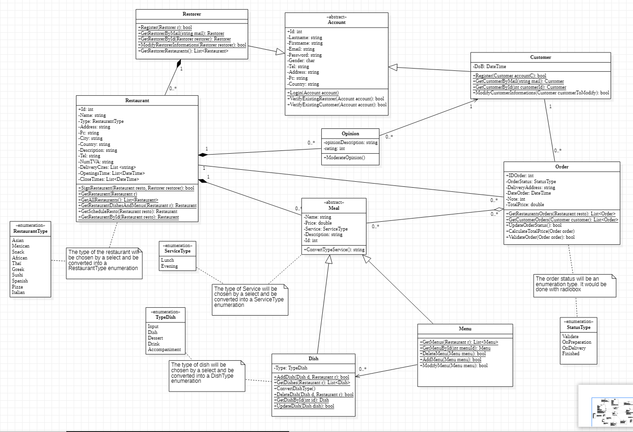
Class diagram : our
generalization and specification
Restorer and customer are account
A
Aggregation
Order contains meals
Composition
The meals belong to the restaurant and if it is destroyed they are also

Slide 11
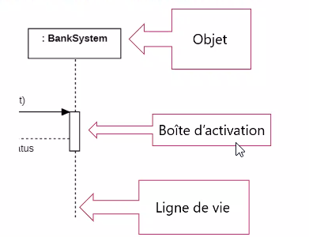
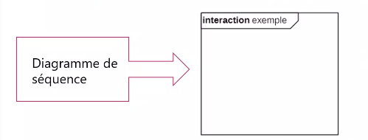
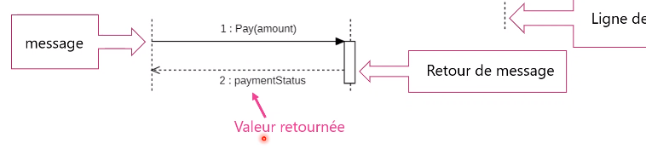
Sequence diagram : theory
A
Interaction diagram.
Shows the behavior of the system through the interaction between the objects that compose it.
The objects will create and interact with each other.
Shows the interactions of objects in a use case.
Object Activation box Lifeline
Diagram sequence
Dialog

Slide 12
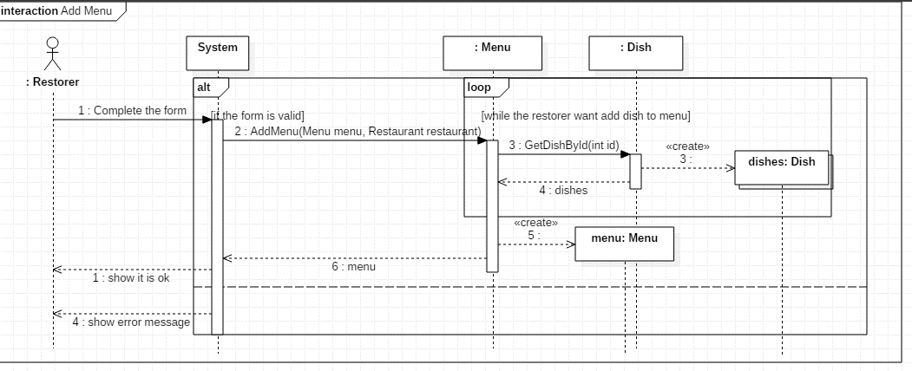
Sequence diagram : 1 / 2 of own
S
(1)

Slide 13
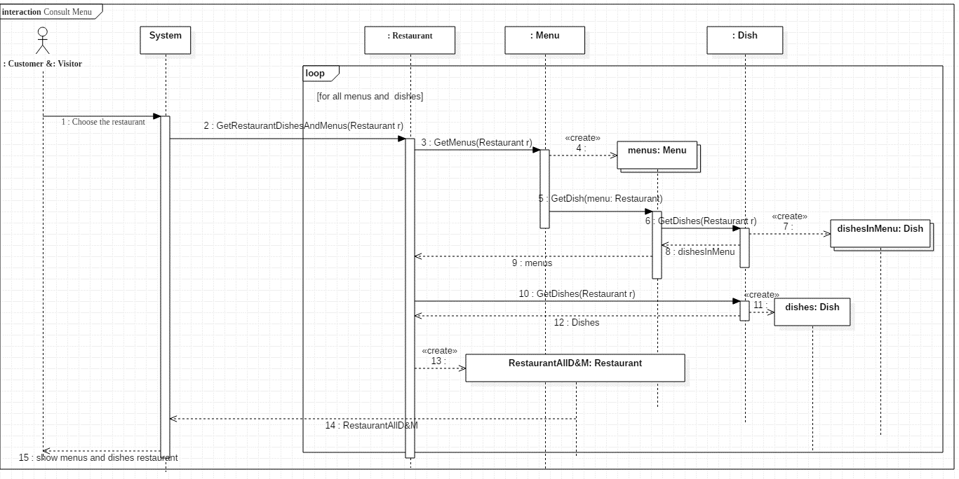
Sequence diagram : 2 / 2 of own
A
(2)

Slide 14
Demo
S
Run ASP_PROJECT

Slide 15
Conclusion
S/A
Simon
Difficulties to do the diagrams
Interresting project
Amandine
Difficult to grasp the object concepts;
Handles pressure badly;
we had a good communication;
I wanted to pass the project for August => discouraged

